Slide 1
story 2
File created on: 10/30/2023 4:59:55 AM

Slide 2
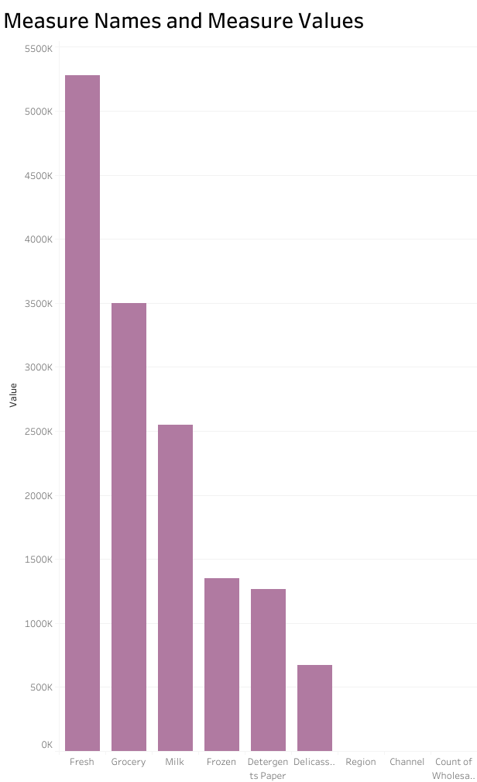

Slide 3
